Slide 1
Climate and Weather

Slide 2
By the end of this lesson on climate and weather, you should be able to:
⋅ | Describe the difference between weather and climate
⋅ | Identify the factors that determine climates on Earth
⋅ | Explain the types of evidence that scientists use to determine past climates

Slide 3
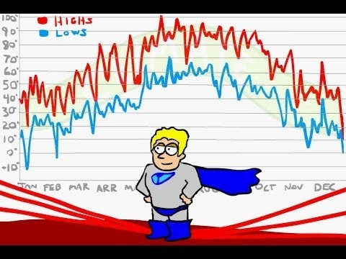

Slide 4
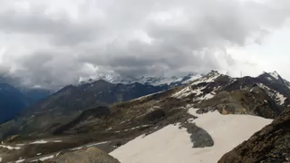
Weather describes the conditions of the atmosphere in terms of temperature, wind, cloud and precipitation (rain/snow/sleet/hail) on a short-term basis (usually day-to-day).

Slide 5
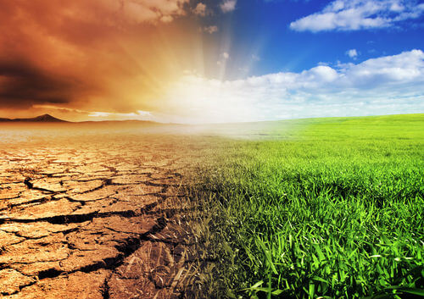
Winds move warm air from high temperature areas to low temperature areas.
Air temperature can also influence the amount of rain an area gets. Warmer air holds more water vapour, so less rain is likely to fall.

Slide 6

Climate is an average of the weather conditions. This includes extreme weather, such as drought, that is experienced over a long period of time.
Usually the weather patterns over the past 30 years are averaged to determine the climate of an area.
Climate can determine where organisms live, depending on how well they can survive certain weather conditions.

Slide 7
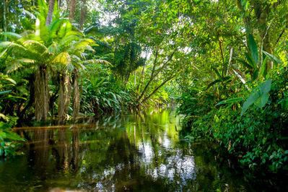
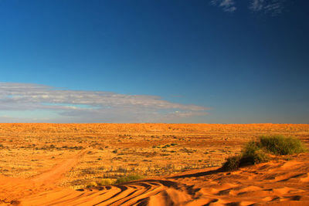
Different places on Earth have very different climates and therefore experience very different patterns of weather.
For example, the average climate in Australia is very different to that of the Amazon Rainforest.

Slide 8


Slide 9

Climate is an average of the weather conditions prevailing over a long period.
There are many things that can influence climate. Some of these include:
⋅ | Uneven heating of the Earth by the Sun
⋅ | Different heat absorption and emission rates of land and water
⋅ | The extent to which Earth's axis tilts
⋅ | Topography of the land
⋅ | Composition of the atmosphere

Slide 10
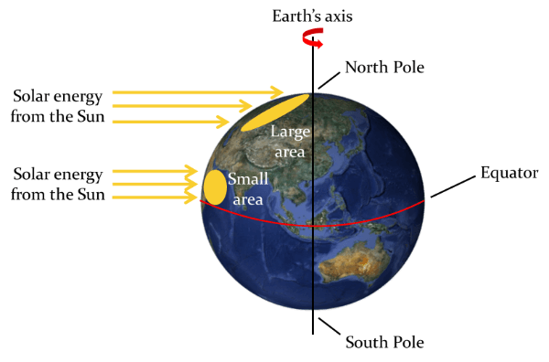
Since the Earth is round, the sun's rays reach different areas of the Earth in different ways.
As seen in the image below, the same amount of heat energy is dispersed over a larger area at the poles, compared to near the equator.

Slide 11
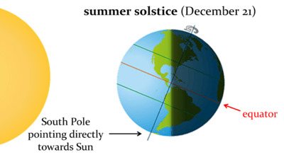
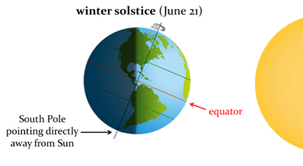
The tilt of the Earth’s axis causes variation in climates in different areas because it means the areas surrounding the poles get little to no sun for 6 months each year.

Slide 12
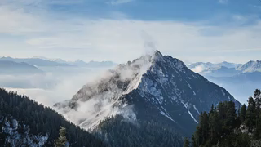
Climate is also influenced by the topography, or surface features of land. For example, the temperature of the atmospheric layer that humans live in decreases with increasing height.
This means that the further above sea level an area is, the lower the average temperature will be.
Mountains can also shelter surrounding areas from wind. This wind is forced upwards to form clouds, when water vapour is quickly condensed in the colder air.

Slide 13
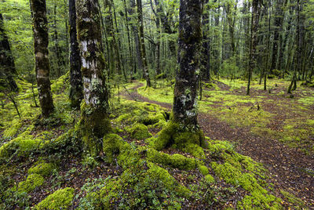
The type of soil and plant life can also affect climate.
Sandy soils reflect much more heat than clay or dark soils and snow reflects almost all of the heat that is radiated on to it!
In areas that contain lots of plants, much more radiated heat from the Sun is absorbed, compared to areas with few or no plants. This is because the plants absorb radiation from the Sun in order to carry out photosynthesis.

Slide 14
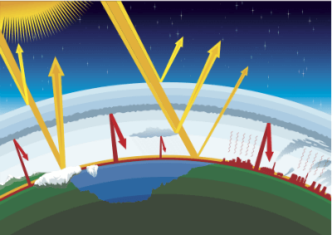
Short-wave energy from the Sun is absorbed by clouds and the surface of the Earth before it is radiated back out into space as heat, or long-wave radiation. Certain gases, known as greenhouse gases, trap long-wave radiation in the atmosphere.
This process is known as the greenhouse effect and it is a natural function that helps to maintain stable temperatures on Earth.

Slide 15
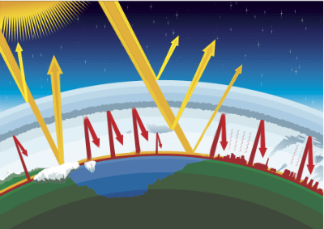
The greenhouse effect is a natural phenomenon, which helps to keep the planet at an average of 15∘C, rather than a chilly −18∘C.
However, release of excess greenhouse gases into the air can cause what is known as the enhanced greenhouse effect. This occurs when more heat is trapped in Earth's atmosphere, increasing the average temperature.
Natural Greenhouse Effect
Enhanced Greenhouse Effect

Slide 16

Climate change occurs when there is a change in average weather patterns (wind, air temperature and precipitation) that lasts for a long time. This change can occur for anywhere between tens to millions of years.

Slide 17
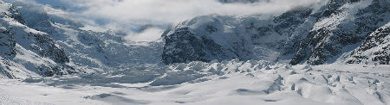
There have been many cycles of warming and cooling throughout Earth's history. These cycles are known as glacial and interglacial periods.
For example, 2.5 million years ago Tasmania and much of southern Australia was covered in an ice sheet.

Slide 18
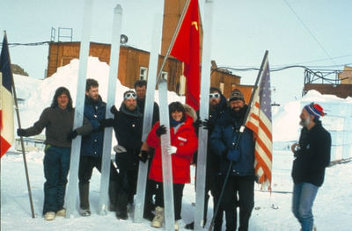
Scientists study an array of evidence in order to determine what the climate was like in the past and how rapidly it changed.
Some of the things that scientists study include:
⋅ | Advance and retreat of glaciers
⋅ | Composition of ice cores
⋅ | Pollen analysis
⋅ | Rise and fall of sea levels

Slide 19


